Slide 1
Update on DTX & Other San Francisco Planning Efforts
May 7, 2020

Slide 2
Update on DTX & Other SF Planning Efforts
Significant work has occurred over the last year to advance and prepare for work on a number of related rail efforts in San Francisco
Key milestone reached with the development of an MOU between Caltrain and other Downtown Extension partners. Signed by Caltrain Executive Director

Slide 3
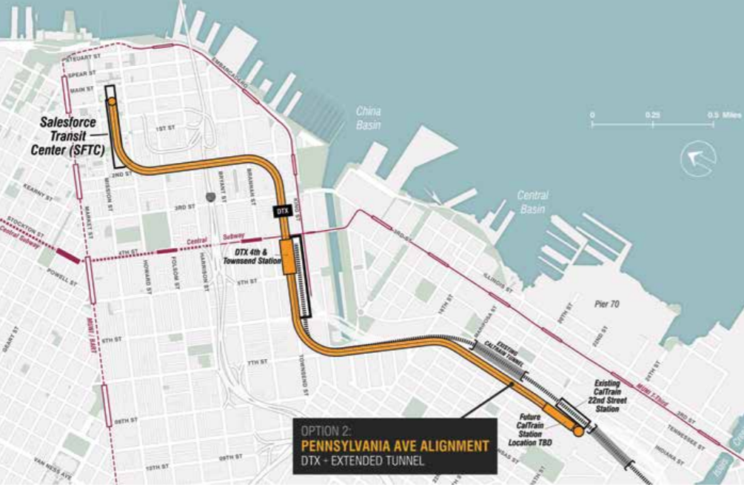
A Program of Projects & Plans
Image from Rail
Alignments & Benefits Study

Slide 4
DTX MOU - Overview
MOU between Caltrain and other DTX partners signed by Caltrain Executive Director
MOU implements recommendations developed in fall of 2019 by the San Francisco County Transportation Authority’s Expert Review Panel to advance DTX program
Major Panel Recommendations Include:
Reposition Rail program – regional/state/national significance
Evaluate initial operating phase options
Develop a viable funding strategy/plan
Evaluate governing entity/organization options
Evaluate and select a project delivery method

Slide 5
DTX MOU - Overview
MOU Partners
Transbay Joint Powers Board
Metropolitan Transportation Commission
California High Speed Rail Authority
Peninsula Corridor Joint Powers Board
City and County of San Francisco
San Francisco County Transportation Authority

Slide 6
DTX MOU - Overview
MOU establishes multi-agency organizational structure to support project development efforts
Executive Steering Committee (ESC) – partner agencies senior executives, responsible for delivering the activities of the Work Program
Supported by an Integrated Project Management Team (IPMT) - representatives with relevant experience in large complex projects from each of the partners
The IPMT will be led by a new Project Director, a TJPA employee or consultant, or a consultant seconded by any of the partners
Establishes a Summary Work Program and assigns responsibilities for execution
Three-year term or ready-for-procurement status
May be extended by agreement of the partners

Slide 7
Overview
MOU Organization Chart And Relationship to Related Projects

Slide 8
4th & King Railyard Studies
Railyard site owned by Prologis Inc with perpetual rail operating easement held by Caltrain
Work underway to understand potential for development of site in conjunction with reconfiguration of yard and delivery of related projects
Planning and technical studies are being undertaken by Caltrain, Prologis and the City and County of San Francisco to determine Caltrain’s long term storage, service, station, and maintenance requirements at 4th & King as well as the potential for future development
Work coordinated through an MOU between TJPA, San Francisco County Transportation Authority, City and County of San Francisco, Prologis and Caltrain

Slide 9
Pennsylvania Avenue Extension (PAX)
Project contemplates an extension of the DTX tunnel southward past the existing railyards, generally following the alignment of Pennsylvania Avenue. Would result in the below-grade separation of at-grade crossings at Mission Bay Drive and 16th Street
Alignment recommend as part of the City’s Rail Alignments and Benefits (RAB) Study, finalized in 2018
Advancing to preliminary engineering and pre-environmental work. Led by SFCTA in coordination with Caltrain and other partners

Slide 10
22nd Street Station
Two parallel studies being undertaken by Caltrain and San Francisco Planning
Caltrain effort focused on assessing feasibility of potential near-term improvements to the station
San Francisco Planning-led study considering long term options and potential to rebuild or relocate station in conjunction with implementation of the PAX project

